Slide 1
A BLE-based multi-gateway network infrastructure with handover support for mobile BLE peripherals
SPEAKER : Jia-Wei Guo
ADVISOR: DR. HO-TING WU
Date: 2020/09/30

Slide 2
Outline
Introduction
Primer on BLE and BLE over IPv6
A BLE-based multi-Gateway network infrastructure
Handover approaches
Implementation details
Evaluation
Conclusion
References

Slide 3
Introduction
Bluetooth Low Energy (BLE) is a popular technology within the Internet of Things. It allows low-power, star networks to be set up between a BLE gateway and multiple , power-constrained BLE devices.
However, these networks tend to be static, not supporting BLE devices that can freely move around in an environment of multiple interconnected BLE gateways and perform handovers whenever necessary.
Notes:
BLE是物聯網中的一種技術。 它允許在BLE gateway和多個功耗受限制的BLE設備之間建立低功耗星狀網路。
但是，這些網路往往是靜態的，不支持可在多個互連的BLE gateway 環境中自由移動，並在必要時執行切換的BLE設備。

Slide 4
Introduction(cont’d)
This research proposes two alternative network architectures for mobile BLE peripherals. One leverages on IPv6 over BLE, whereas the other combines default BLE mechanisms with an additional custom controller.
On top, this team studies in detail the handover mechanism that must be present in both architectures and compare the performance of both a passive and active handover approach.
Notes:
這項研究針對行動BLE周邊設備提出了兩種替代網路架構。 一種利用BLE上的IPv6，而另一種則結合了原先的BLE機制和自定義的控制器。
最重要的是，該團隊詳細研究了兩種體系結構中都必須存在的切換機制，並比較了被動和主動切換方法的性能。

Slide 5
Primer on BLE and BLE over IPv6
Bluetooth Low Energy (BLE) was released in 2011 as part of the Classic Bluetooth specification and both technologies have coexisted and evolved independently since then.
BLE operates in the 2.4 GHz band, utilizing frequencies between 2402 and 2480MHz. The used spectrum is divided into 40 channels, each employing a space of 2 MHz. These channels are divided into 3 primary advertisement channels and 37 connection-oriented channels.
BLE supports two different ways of communication : an advertising mode and a connection-oriented mode.
Notes:
藍牙低功耗（BLE）於2011年發布，是Bluetooth classic規範的一部分。
BLE在2.4 GHz頻段內使用2402和2480MHz之間的頻率工作。 使用的頻譜分為40個通道，每個通道佔用2 MHz的空間。 這些頻道分為3個主要廣告頻道和37個面向連接的頻道。
BLE支持兩種不同的通信方式：廣告模式和面向連接的模式。

Slide 6
Primer on BLE and BLE over IPv6(cont’d)
In advertising mode , a device can either be in an advertising or scanning state. A BLE advertiser broadcasts advertisement packets on the 3 advertisement channels sequentially, at a certain interval.
A BLE scanner scans one of these advertisement channels, also shifting between them at a certain interval.
Notes:
在廣告模式下，設備可以處於廣告或掃描狀態。 BLE廣告客戶以一定間隔在三個廣告頻道上順序廣播廣告包。
BLE scanner 掃描這些廣告頻道之一，並以一定間隔在它們之間切換。

Slide 7
Primer on BLE and BLE over IPv6(cont’d)
if the BLE scanner is configured to listen for connectable advertisements, meaning it has the intention of employing these advertisements to initiate a BLE connection with a device that is broadcasting connectable advertisements.
In order to set up such a connection, the initiator sends a connection request back to the broadcasting device, using the advertisement channel where the connectable advertisement was received on.
Notes:
如果BLE scanner設定為偵聽可連接的廣告，則意味著，它打算使用這些廣告來啟動與正在廣播可連接廣告的BLE設備連接。
為了建立這樣的連接，發起方使用接收可連接廣告的廣告頻道將連接請求發送回廣播設備。

Slide 8
Primer on BLE and BLE over IPv6(cont’d)
To be able to receive a connection request, the broadcasting device should be listening on that advertisement channel as well.
So after transmitting a connectable advertisement on an advertisement channel, the BLE advertiser listens on that channel until the part of the advertising event for that advertisement channel, is over.
Notes:
為了能夠接收連接請求，使用broadcast的設備也應該在該廣告頻道上收聽。
因此，在廣告頻道上發送可連接廣告後，BLE廣告客戶會在該頻道上進行監聽，直到該廣告頻道的廣告事件部分結束為止。

Slide 9
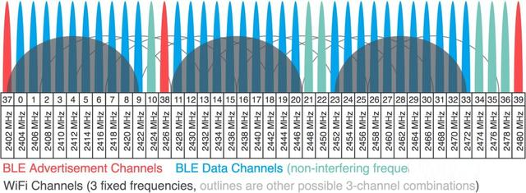
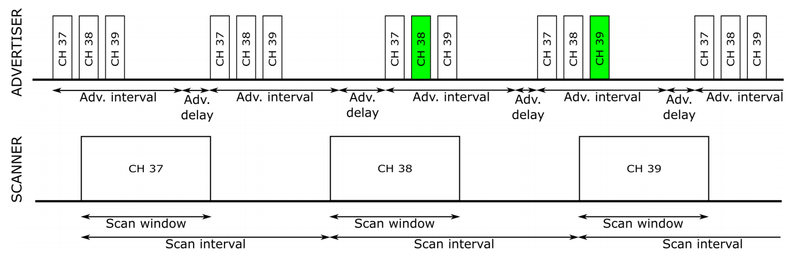
Primer on BLE and BLE over IPv6(cont’d)
Channels
advertising mode

Slide 10
Primer on BLE and BLE over IPv6(cont’d)
In connection-oriented mode, one device acts as a BLE central and the other device acts as a BLE peripheral.
The devices communicate within connection events, at a certain interval and initiated by the central.
Use Frequency-hopping spread spectrum(FHSS) and Time division multiple access(TDMA) to communicate.
Notes:
在面向連接模式下，一個設備充當BLE中心，另一設備充當BLE周邊。
設備在連接事件中以一定的時間間隔進行通信，並由中心發起。
使用跳頻展頻（FHSS）和分時多工（TDMA）進行通信。

Slide 11
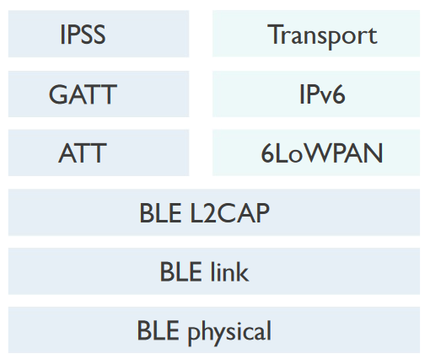
Primer on BLE and BLE over IPv6(cont’d)
About BLE over IPv6.
It exploits the existing BLE stack layers and adds a 6LoWPAN layer between the BLE layers and the IP layer.
Notes:
關於BLE over IPv6。
它利用現有的BLE協議，並在BLE層和IP層之間添加6LoWPAN層。

Slide 12
Primer on BLE and BLE over IPv6(cont’d)
The BLE central acts as 6LoWPAN border router (6LBR) and one or more BLE peripherals as 6LoWPAN nodes (6LN), resulting in an isolated IPv6 over BLE subnet.
The 6LoWPAN border router can also be connected to the Internet, ultimately allowing end-to-end IPv6 connectivity between a BLE peripheral and any application server on the Internet.
Notes:
BLE中心充當6LoWPAN邊界路由器（6LBR），一個或多個BLE外設充當6LoWPAN節點（6LN），從而在BLE子網路上形成隔離的IPv6。
6LoWPAN邊界路由器也可以連接到Internet，最終允許BLE周邊設備與Internet上任何應用程序服務器之間的end-to-end IPv6連接。

Slide 13
A BLE-based multi-Gateway network infrastructure
For the design of our BLE-based multi-GW network infrastructure, this research considers two variants.
Further called IP and non-IP, should be able to achieve seamless handover within the network of IoT gateways.
Notes:
對於基於BLE的multi-gateway網路基礎架構的設計，本研究考慮了兩種變體。
進一步稱為IP和非IP，應該能夠在IoT gateway網路內實現無縫切換。

Slide 14
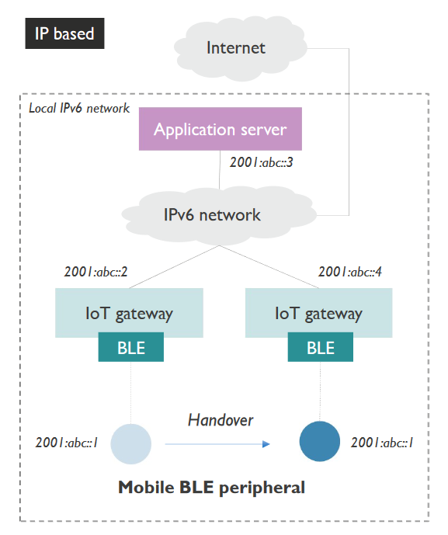
IP based architecture
BLE peripheral. The BLE peripheral needs to mold its native BLE stack in order to support IPv6 over BLE.
The peripheral generates a link-local address derived from the device’s BLE MAC address and a global IPv6 address based on a common prefix.
In order to move around inside a network of IoT GWs and perform handovers, the peripheral should always be in one of two states:
a) in connection with an IoT GW
b) advertising its presence to nearby IoT GWs using BLE advertisements.
Notes:
基於IP的架構
BLE周邊。 BLE周邊需要模製其本機BLE協議，以支持BLE上的IPv6。
周邊設備會根據設備的BLE MAC地址和基於通用前綴的全局IPv6地址生成一個本地鏈接地址。
為了在IoT GW網絡內部移動並執行切換，外圍設備應始終處於以下兩種狀態之一：
a）與物聯網Gateway連接
b）使用BLE廣告向附近的物聯網Gateway宣傳其存在。

Slide 15
IP based architecture(cont’d)
The IoT GW should be able to support theIPv6 over BLE stack, while at the same time taking on the role of IPv6 router and neighbor proxy towards the existing IPv6 network.
The peripheral acquires a global IPv6 address usable within the IPv6 network, stateless address autoconfiguration is used.
Notes:
IoT gateway應該能夠支持BLE協議上的IPv6，同時擔當著IPv6路由器和針對現有IPv6網絡的鄰居代理的角色。
周邊設備使用無狀態地址自動配置。獲取可在IPv6網絡中使用的全局IPv6地址。(SLAAC)

Slide 16
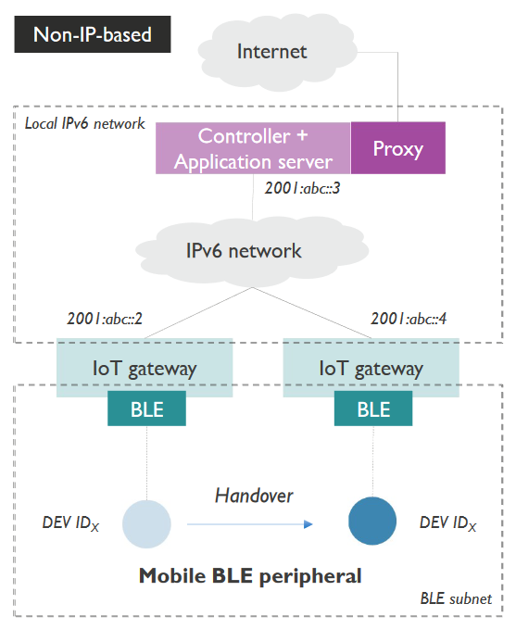
Non-IP based architecture
For BLE peripheral.
As no IP is used , to set up IoT connectivity between the BLE peripheral and the controller, no extra implementation is needed on the peripheral apart from setting up native BLE communication.
In order to achieve seamless handover, the peripheral is in one of two states at all times:
a) in a BLE connection with an IoT GW,
b) advertising its presence using BLE advertisements.
Notes:
由於未使用IP，因此要在BLE周邊設備和控制器之間建立IoT連接，除了設置本機BLE通信外，無需在周邊設備上進行任何額外的實作。
為了實現無縫切換，外圍設備始終處於兩種狀態之一：
a）與IoT gateway連接
b）使用BLE廣告來廣告自身存在。

Slide 17
Non-IP based architecture(cont’d)
IoT gateway , The gateway should expose the BLE peripheral towards the IP network in an application agnostic way.
the IoT GW only has a forwarding role and is unaware of the application layer connectivity between the BLE peripheral and the controller.
Notes:
IoT gateway，Gateway應以與應用程序無關的方式向IP網路公開BLE外圍設備。
IoT gateway僅具有轉發作用，並且不知道BLE外圍設備與控制器之間的應用程序層連接。

Slide 18
Non-IP based architecture(cont’d)
Controller.
The IoT GWs notify the controller when a new connection is established or a disconnection occurs.
Therefore,the controller should keep a mapping table, linking each BLE peripheral to its current corresponding IoT GW.
The peripherals are identified via an implementation specific device ID. To expose the BLE peripheral to the Internet, the controller could act as a proxy or bridge, hereby translating the application layer to another protocol.
Notes:
控制器。
建立新連接或發生斷開連接時，IoT gateway會通知控制器。
因此，控制器應保留一個映射表，將每個BLE周邊設備鏈接到其當前對應的IoT gateway。
周邊設備透過特定的設備ID進行標識。 為了將BLE周邊設備擺在Internet，控制器可以充當代理或橋接器，從而將應用程序層轉換為另一個協議。

Slide 19
Handover approaches
About passive handover:
A BLE connection is terminated naturally after the supervision timeout has timed out. Only then, the BLE peripheral attempts to set up a new connection by advertising its presence using BLE advertisements.
When using the passive handover approach, a connection to a new and better GW will only be established when the previous connection was completely broken, i.e. when no traffic could be sent during the supervision timeout range.
As such, it might happen that a peripheral remains connected even when the link quality becomes very poor.
Notes:
關於被動切換：
監管超時後，BLE連接自然終止。 只有這樣，BLE周邊設備才會嘗試通過使用BLE廣告來廣告其存在來建立新連接。
當使用被動切換方法時，僅當先前的連接完全斷開時，即在監管超時範圍內無法發送流量時，才會建立與新的更好Gateway的連接。
這樣，即使鏈路質量非常差，外圍設備仍可能保持連接狀態。

Slide 20
Handover approaches(cont’d)
About active handover :
The BLE peripheral maintains an advertiser role at all times.
The IoT GWs use these periodic BLE advertisements to derive a Received Signal Strength Indicator (RSSI).
Notes:
關於主動切換：
BLE周邊設備始終保持廣告商角色。
IoT gateway使用這些週期性的BLE廣告來得出接收信號強度指示器（RSSI）。

Slide 21
Handover approaches(cont’d)
All collected RSSI values are forwarded to the controller.
The controller maintains a mapping table between the received RSSI values and the associated IoT GW and BLE peripheral.
Concurrently, this mapping table is used to monitor the current state of the BLE connections and decides whether a specific BLE peripheral should handover to another IoT GW.
Notes:
所有收集的RSSI值都轉發到控制器。
控制器維護收到的RSSI值與關聯的IoT Gateway和BLE外設之間的映射表。
同時，此映射表用於監視BLE連接的當前狀態，並確定特定BLE周邊設備是否應切換到另一個IoT Gateway。

Slide 22
Handover approaches(cont’d)
Such a handover decision is taken when two conditions are met: the connection to the current IoT GW is bad and a sufficiently good enough alternative IoT GW is available.
The connection can be considered bad once the RSSI exceeds a certain RSSI threshold, meaning that the peripheral is not too far from the GW for the connection to be lost, but far enough to be of insufficient quality.
Another GW can be considered a sufficient alternative, once its RSSI exceeds a certain threshold as well, indicating that the peripheral is actually close enough to that GW to establish a connection of sufficient quality.
Notes:
當滿足兩個條件時，將做出此類切換決策：與當前IoT Gateway的連接不良，並且有足夠好的替代物IoT Gateway可用。
一旦RSSI超過某個RSSI閾值，就可以認為該連接是不良的，這意味著外圍設備離Gateway不會太遠，以至於丟失連接，但是其質量足以不足。
一旦另一個Gateway的RSSI也超過某個閾值，就可以認為另一個Gateway是一個足夠的替代方案，這表明外圍設備實際上與該Gateway足夠接近，可以建立足夠質量的連接。

Slide 23
Handover approaches(cont’d)
When a handover decision is made, a disconnect message is sent by the controller to the old IoT GW and a connect message to the alternative IoT GW.
The old IoT GW forwards this request to the BLE peripheral and the peripheral immediately terminates the connection (independent of the supervision timeout).
Afterwards, the BLE advertisements can be answered with a connection request again, which is now done by the alternative gateway incited by the connect message.
Notes:
做出切換決定後，控制器將斷開消息發送到舊的IoT Gateway，將連接消息發送到備用IoT Gateway。
舊的IoT Gateway將該請求轉發到BLE周邊設備，立即終止連接（與監管超時無關）。
之後，可以再次通過連接請求來回答BLE通告，該請求現在由觸發連接消息的備用Gateway來完成。

Slide 24
Handover approaches(cont’d)
On top, when a BLE peripheral does not yet have a BLE connection with an IoT GW, the current best RSSI is can be used to find a suitable IoT GW and set up the connection.
When an IoT GW naturally loses a BLE connection, which can occur if no suitable alternative was available, or a BLE connection failed to be set up, the controller is also notified, such an event indicates that the BLE peripheral has moved out of range of the BLE-enabled infrastructure or the infrastructure contains a blind spot.
Notes:
最重要的是，當BLE周邊設備尚未與IoT Gateway建立BLE連接時，可以使用當前最佳的RSSI來找到合適的IoT Gateway並建立連接。
當IoT Gateway自然失去BLE連接時（如果沒有合適的替代方案時可能發生），或者BLE連接建立失敗，也會通知控制器，這樣的事件表明BLE外圍設備已超出BLE範圍。 或基礎架構包含盲點。
這邊的盲點是指，預期能在這一個範圍中的任何一處皆能連線，但實際上有一些地點會無法連線。

Slide 25
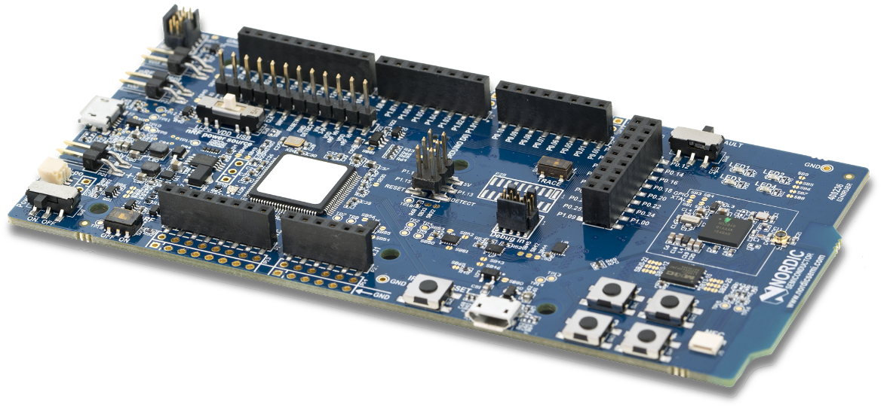
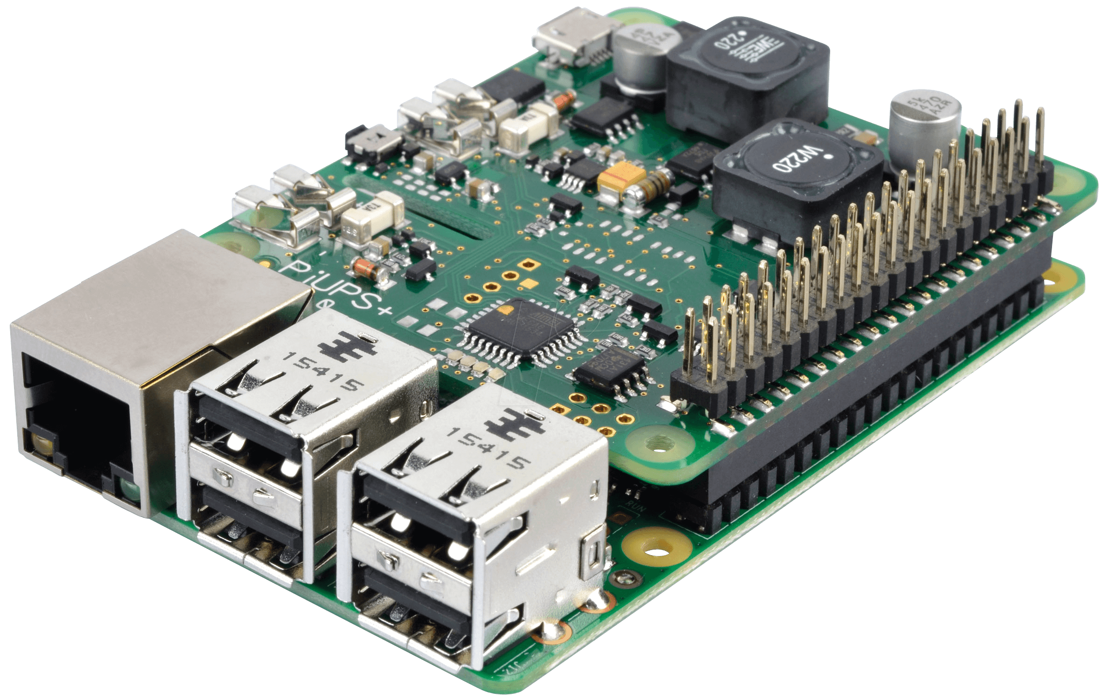
Implementation details
The BLE peripheral’s role is enacted using a nRF52840 board and the other roles(GW,Controller) are enacted using Raspberry PI’s.
nRF52840 board is capable of implementing a complete BLE v5.0 supported stack as well as the IPv6 over BLE stack adjustment.
Notes:
BLE周邊設備的角色是通過nRF52840電路板製定的，其他角色（GW，控制器）是通過Raspberry PI制定的。
nRF52840板能夠實現完整的BLE v5.0協議以及IPv6 over BLE協議調整。

Slide 26
Implementation details
Use BlueZ on Raspberry Pi.
BlueZ is the official Linux Bluetooth stack. It provides, in it's modular way, support for the core Bluetooth layers and protocols.
To emulate a mobile BLE peripheral performing a handover from one gateway to another gateway, in a controller manner, a manual attenuator is used.
Notes:
在Raspberry Pi上使用BlueZ。
BlueZ是官方的Linux藍牙協議。 它以模組化的方式提供對核心藍牙層和協議的支持。
為了模擬執行控制器從一個Gateway到另一Gateway的切換的BLE周邊設備，使用了手動衰減器。

Slide 27
Evaluation
The performance of the handover process is predominantly impacted by two steps: disconnecting from the current GW and setting up a connection with the alternative GW.
Notes:
切換過程的性能主要受兩個步驟的影響：與當前Gateway斷開連接以及與備用Gateway建立連接。

Slide 28

Evaluation : passive handover
About disconnecting from current GW
The supervision timeout should not be too low , to avoid unnecessary triggering of the handover procedure.
However , a too high supervision timeout can have a significant impact on the handover latency.
According to the BLE standard, Supervision timeout should be larger than
$$(1+slave latency) ∗ connection interval$$
Notes:
關於與當前Gateway斷開連接
監督超時不應太低，以避免不必要地觸發切換過程。
但是，過高的監督超時可能會對切換延遲產生重大影響。
Paper的公式是錯的。

Slide 29
Evaluation : passive handover(cont’d)
About setting up a connection with the alternative GW
Once the BLE peripheral’s supervision timeout has timed out, it transitions back to the advertising state, broadcasting connectable advertisements at a certain advertising interval.
A GW that is not in a connection or still has room for another BLE connection, is in the initiating state and attempts to set up a connection upon receiving the connectable advertisements from the BLE peripheral.
Notes:
關於與備用Gateway建立連接
BLE周邊設備的監督超時超時後，它將轉換回廣告狀態，並在特定廣告間隔內廣播可連接的廣告。
未處於連接狀態或仍具有另一個BLE連接空閒的Gateway處於啟動狀態，並在從BLE周邊設備接收到可連接的通告後嘗試建立連接。

Slide 30
Evaluation : passive handover(cont’d)
About BLE parameter combinations
The advertising interval should be smaller or equal to the scan window, because otherwise it cannot be guaranteed that the GW will be able to receive a connectable advertisement in an acceptable time window.
A higher scan duty cycle ( scan window/scan interval ) has a positive impact on the handover latency but a negative impact on the energy consumption of the GW.
Notes:
關於BLE參數組合
廣告間隔應小於或等於掃描窗口，因為否則不能保證Gateway將能夠在可接受的time windows內接收可連接的廣告。
較高的掃描佔空比（scan window/scan interval）對切換延遲有正面影響，但對Gateway的能耗有負面影響。
但較高的掃描佔空比可降低外圍設備的功耗，因為可較快接收到advertising。

Slide 31
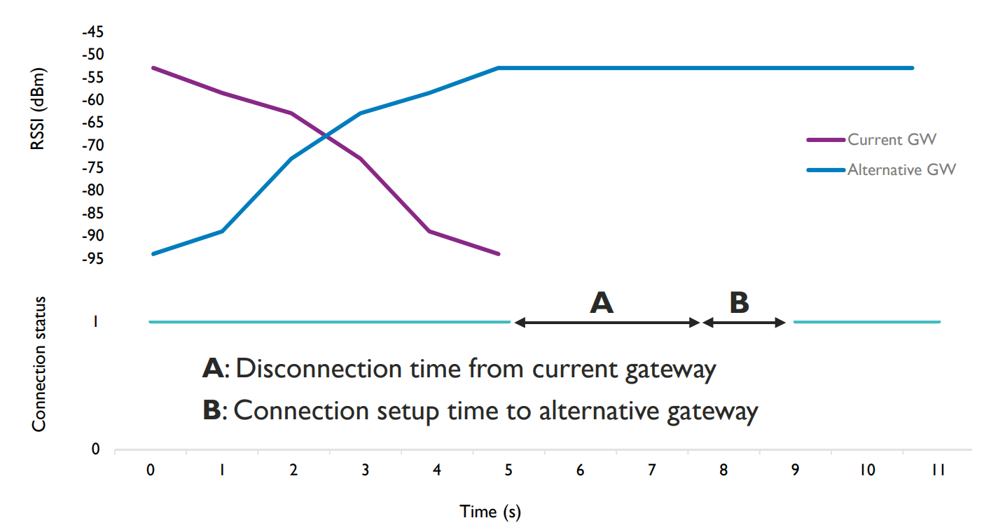
Evaluation : passive handover(cont’d)

Slide 32
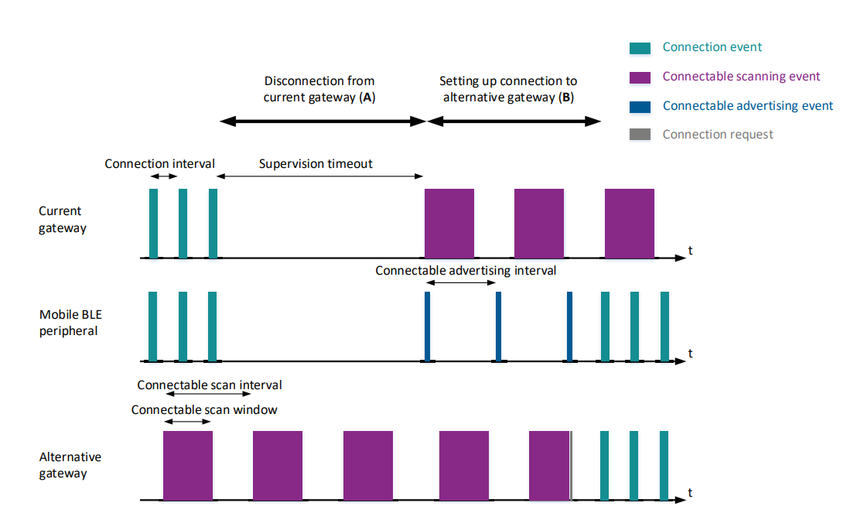

Slide 33
Evaluation : active handover
About disconnecting from current GW
the current GW will receive a disconnection message from the controller once a roaming decision has made.
After receiving this message, the GW immediately attempts to send a disconnection request to the BLE peripheral.
Upon receiving this request, the peripheral answers with a disconnection acknowledgment.
Notes:
關於與當前Gateway斷開連接
一旦做出漫遊決定，當前Gateway將收到來自控制器的斷開連接消息。
收到此消息後，Gateway立即嘗試向BLE外圍設備發送斷開連接請求。
收到此請求後，周邊設備會以斷開確認的方式回應。

Slide 34
Evaluation : active handover(cont’d)
About Setting up a connection with the alternative GW
Once the disconnection has been finalized, the BLE peripheral switches from a connection/advertising state to solely an advertising state, broadcasting connectable advertisements.
In the meantime, the alternative GW has received a connect message from the controller and has switched from nonconnectable to connectable scanning, specifically for the MAC address of the BLE peripheral at hand.
From this point, the handover process is similar to passive handover.
Notes:
關於與備用Gateway建立連接
一旦斷開完成，BLE外圍設備將從連接/廣告狀態切換到僅廣告狀態，從而廣播可連接廣告。
同時，備用Gateway已從控制器接收到連接消息，並且已從不可連接掃描切換為可連接掃描，特別是針對當前BLE周邊設備的MAC位址。
從這一點來看，切換過程類似於被動切換。

Slide 35
Evaluation : active handover(cont’d)
Potential Optimizations
The BLE peripheral constantly needs to advertise , This increases energy consumption and decreases the quality of the BLE connection as well.
A possible improvement could employ a proactive decision on when to start and stop advertising. The peripheral can monitor the quality of the current connection (i.e. via RSSI) and decide via these indicators whether it is necessary to advertise its presence or not.
Notes:
潛在優化
BLE周邊設備經常需要做廣告，這會增加能耗並降低BLE連接的質量。
可能的改進可以採用主動決定何時開始和停止廣告。周邊設備可以監視當前連接的質量（即通過RSSI），並通過這些指示符來確定是否有必要通告其存在。

Slide 36
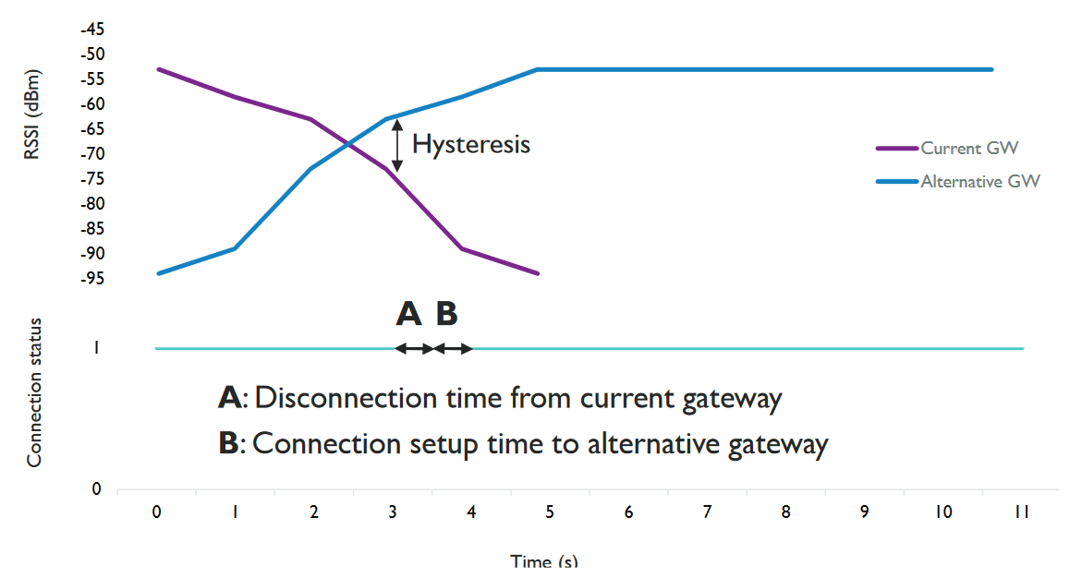
Evaluation : active handover(cont’d)
Notes:
遲滯現象

Slide 37
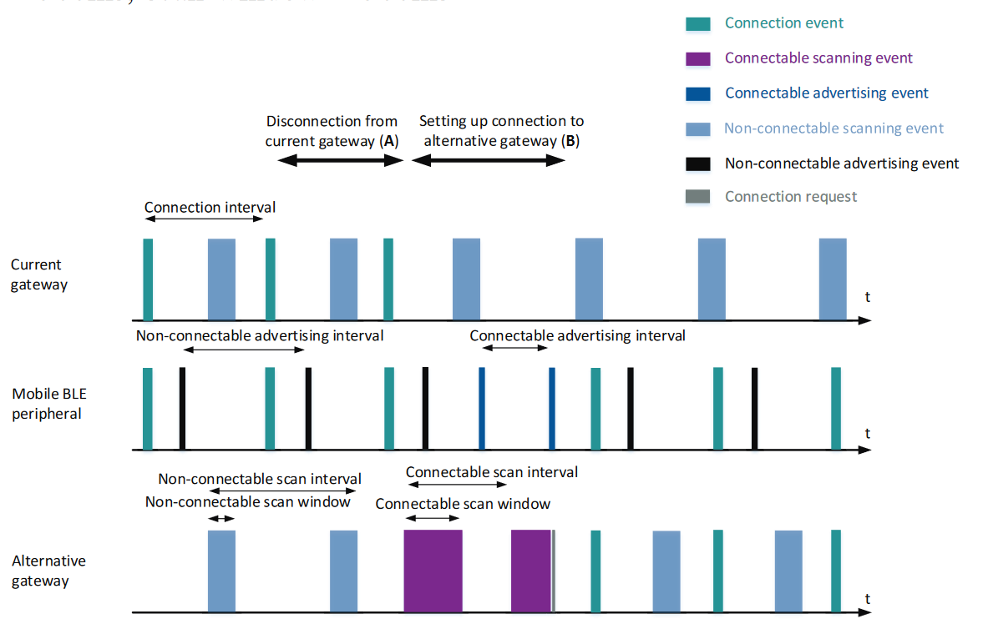
Notes:
Disconnection要先傳資料給外圍設備通知他斷線。

Slide 38
Evaluation(cont’d)
During a handover process, the BLE peripheral is not reachable from application servers. This implies possible data loss.
The newest BLE standard allows a BLE peripheral to be in a connection with multiple BLE centrals at once.
Allowing the current GW to keep its connection with the BLE peripheral, until the new connection with the alternative GW is established.
Notes:
在切換過程中，無法從應用程序服務器訪問BLE周邊設備。 這意味著可能會丟失數據。
最新的BLE標準允許BLE周邊設備一次與多個BLE中心連接。(BLE5.1)
允許當前Gateway保持其與BLE周邊設備的連接，直到建立與備用Gateway的新連接為止。
這樣，始終具有可以利用的BLE連接，因此不會發生數據丟失。

Slide 39
Evaluation(cont’d)
Finally, to avoid constant switching between connectable and non-connectable scanning, two separate BLE modules could be used on the same GW.
One module is in charge of connectable scanning and maintains existing BLE connections.
The other module performs only non-connectable scanning, continuously sending RSSI log messages to the controller.
Notes:
最後，為避免在可連接和不可連接掃描之間不斷切換，可以在同一Gateway上使用兩個單獨的BLE模組。
一個模組負責可連接的掃描，並維護現有的BLE連接。
另一個模組僅執行不可連接的掃描，連續向控制器發送RSSI日誌消息。

Slide 40
Conclusion
In this research, two architectures are proposed to realize a BLE-based multi-GW network infrastructure that is able to provide bidirectional connectivity to mobile BLE peripherals.
The IP based architecture offers seamless end-to-end IP connectivity between a mobile BLE peripheral and an existing IP network. It limits custom implementation needs, but requires more resources from the already constrained mobile BLE peripheral.
Notes:
在這項研究中，提出了兩種架構來實現基於BLE的multi-Gateway網路基礎架構，該架構能夠提供與BLE周邊設備的雙向連接。
基於IP的體系結構在BLE周邊設備與現有IP網路之間提供了無縫的端到端IP連接。 它減少了自定義實現需求，但需要從已經受限的BLE周邊設備中獲取更多資源。

Slide 41
Conclusion(cont’d)
The non-IP based architecture requires less resources from the BLE peripheral as it employs native BLE communication towards the IoT gateway.
However, custom implementation needs are much higher, as a dedicated controller is introduced within the existing network that needs to maintain the state of the infrastructure and the currently associated mobile BLE devices.
Notes:
基於非IP的體系結構由於採用了面向IoT Gateway的BLE連線，因此從BLE周邊設備需要的資源更少。
但是，自定義實現的需求要高得多，因為在現有網路中引入了專用控制器，該控制器需要維護基礎結構和當前關聯的BLE周邊設備的狀態。

Slide 42
Conclusion(cont’d)
Next to this, two approaches are considered to perform handover within these solutions.
The passive handover approach does not need any extra implementation, but the handover latency can become quite high and a bad BLE connection is still maintained even if a better alternative GW is available nearby.
Notes:
緊接著，在這些解決方案中考慮了兩種方法來執行切換。
被動切換方法不需要任何額外的實現，但是即使附近有更好的替代Gateway，切換等待時間也可能變得很高，並且BLE連接仍會保持不良。

Slide 43
Conclusion(cont’d)
Active handover offers a solution by proactively terminating a bad connection when a better alternative GW is available. As such, it can limit the handover latency.
As a downside, this approach requires more extensive custom implementation, implies a higher energy consumption and can limit the available throughput.
Notes:
主動切換通過在更好的替代Gateway可用時主動終止不良連接來提供解決方案。 這樣，它可以限制切換延遲。
不利的一面是，這種方法需要更多的自定義實現，這意味著更高的能耗並可能限制可用的吞吐量。

Slide 44
References
Mathias Baert, Pieterjan Camerlynck, Pieter Crombez, Jeroen Hoebeke, “A BLE-Based Multi-Gateway Network Infrastructure with Handover Support for Mobile BLE Peripherals” in IEEE Internatonal Conference on Mobile Adhoc and Sensor Systems (IEEE MASS 2019) , DOI: 10.1109/MASS.2019.00020
M. Nikodem, M. Bawiec, “Experimental Evaluation of Advertisement-Based Bluetooth Low Energy Communication”, MDPI Sensors 2020, DOI:10.3390/s20010107
Tomohiro Kuroda, Haruo Noma, Kazuhiko Takase, Shigeto Sasaki, Tadamasa Takemura, “Bluetooth Roaming for Sensor Network System in Clinical Environment” , MEDINFO 2015: eHealth-enabled Health, DOI:10.3233/978-1-61499-564-7-198

